Slide 1

3 AM ON-CALL INTELLIGENCE
NoBugs
Sharp ears for 3 AM outages.
Find the signal in the noise. Turn 10,000 log lines into actionable incidents in seconds.
Automated log intelligence • Built for high-pressure on-call SREs
Notes:
Cover. NoBugs is a log-analysis web app for on-call engineers.

Slide 2
About NoBugs
When production breaks at 3 AM, nobody wants to grep through thousands of lines. NoBugs ingests raw logs, clusters them into incident patterns, ranks them by impact, and shows how a failure spread across services.
10,000
39
Log lines ingested
Incident patterns (Drain3)
7
0
No regexes. No manual triage. Drop in .log, .txt or .json files, or paste a dump from Datadog, Grafana or a terminal.
Services in topology
Secrets leaked (privacy shield)
Figures from the 10,000-line sample incident loaded in the demo.

Slide 3
Six intelligence views
1
2
3
Home / Import
Incident Dashboard
Graph Analysis
Ingest or paste logs
Clustered template rankings
Causality and blast radius
4
5
6
Time Machine
Incident Ledger
Fix Verification
Onset replay slider
Postmortems and fixes
Compare before / after

Slide 4
How it works
01
02
03
04
Ingest
Cluster
Rank
Trace
›
›
›
Upload a file or paste raw logs; secrets and PII are scrubbed on the way in.
Drain3 miner groups lines into templates, with variable parts masked.
Score = severity × frequency × blast radius × rate of change.
Map the cascade across services and replay it on the time machine.

Slide 5
Why NoBugs is unique
Zero regex setup
Built-in privacy shield
Causality & blast radius
Adversarial AI
Drain3 template mining clusters 10,000+ log lines into clean patterns in under 0.5 seconds.
Redacts API keys, JWTs, passwords, emails and IPs before any data touches the AI.
Maps how failures cascade (db → payment → checkout) and separates confirmed outages from predicted at-risk systems.
Gives 3 competing hypotheses with contrary evidence, plus a one-click “Challenge This Theory” button.
Incident Time Machine
Institutional memory
Fix verification engine
Scrub an interactive timeline and replay the exact sequence of events as services broke down.
Matches new incident fingerprints against past postmortems to suggest fixes that worked before.
Compares logs before and after a patch to verify error reductions and issue a resolution verdict.
Notes:
What sets NoBugs apart from generic log search and dashboards.

Slide 6
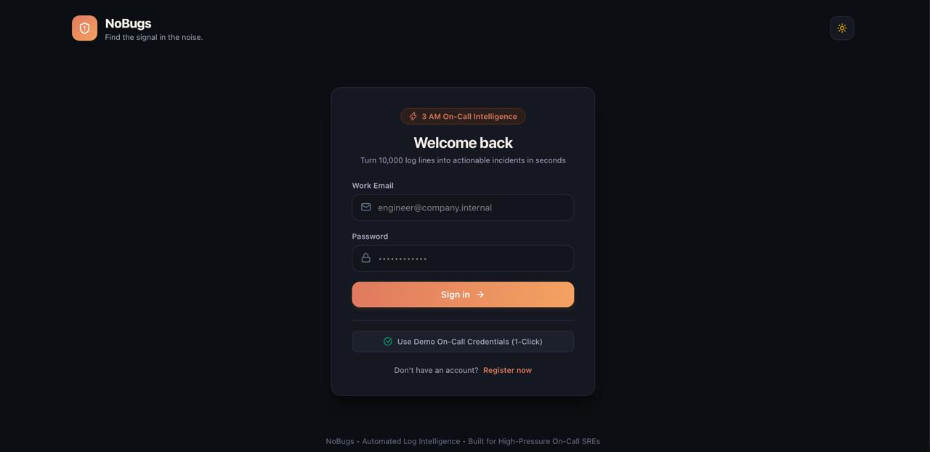
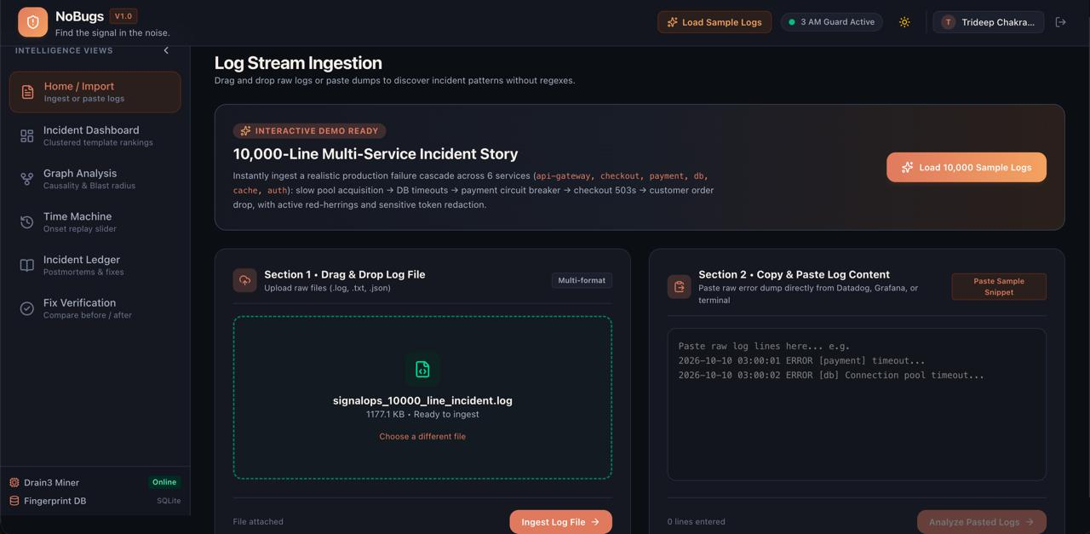
Sign in and ingest
Login. Work email sign-in, plus a one-click demo on-call account.
Ingestion. Drag and drop a file or paste a dump; load the 10,000-line sample story in one click.

Slide 7
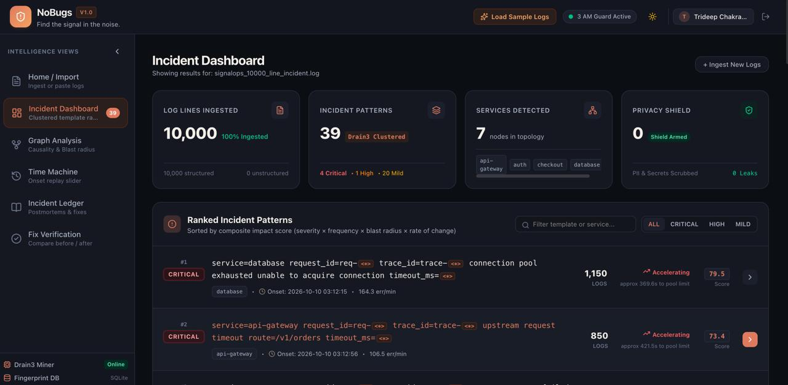
Incident Dashboard
Ranked patterns
Sorted by composite impact score across severity, frequency, blast radius and rate of change.
Severity mix
4 critical, 1 high and 20 mild patterns among the 39 found.
Top finding
Database connection pool exhaustion: 1,150 logs, score 79.5, accelerating.

Slide 8
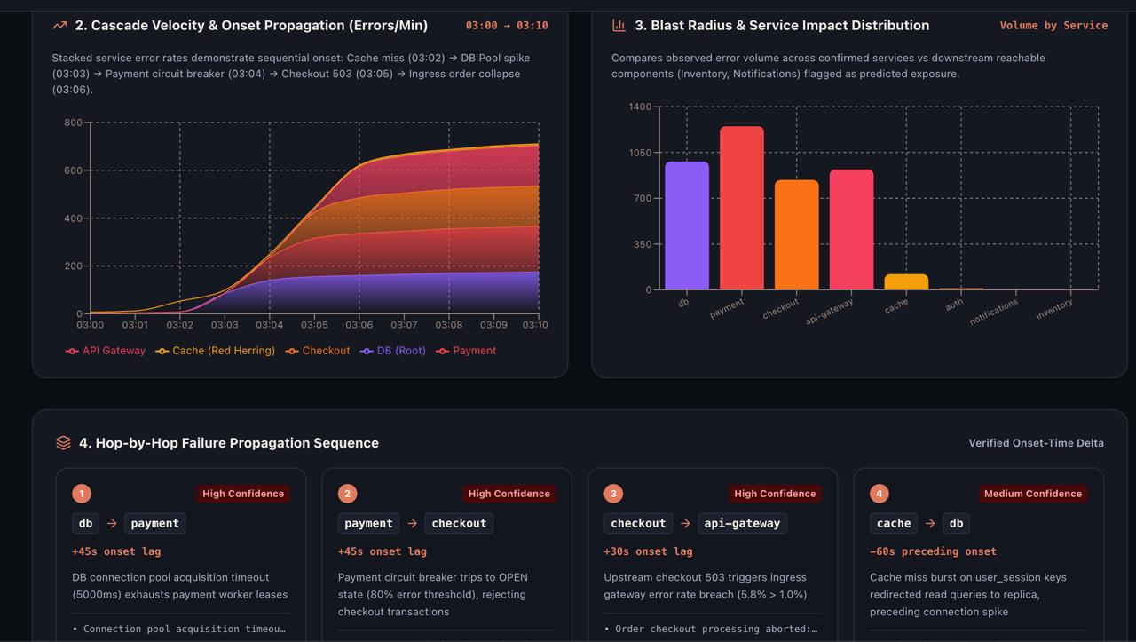
Graph Analysis: cascade and blast radius
Cascade velocity
Stacked error rates show onset order from 03:00 to 03:10.
Blast radius
Error volume by service, plus predicted exposure for inventory and notifications.
Hop-by-hop
db → payment → checkout → api-gateway, each with a confidence rating and onset lag.

Slide 9
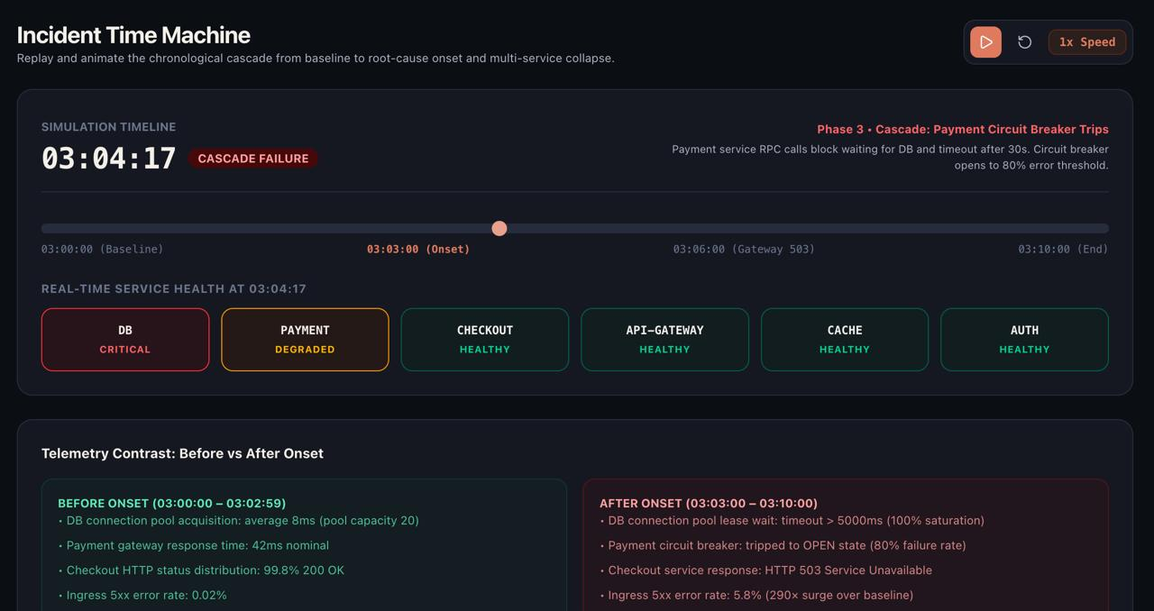
Incident Time Machine
Replay the failure
Scrub or play from baseline (03:00) to the end (03:10).
Live service health
Per-service status at any moment, such as DB critical and payment degraded at 03:04.
Before vs after
Telemetry contrast around onset, e.g. ingress 5xx rate up 290× over baseline.

Slide 10
The demo incident, minute by minute
03:02
03:03
03:04
03:05
03:06
Cache miss burst
DB pool exhausted
Payment breaker opens
Checkout 503s
Gateway collapse
Red herring that precedes the spike
Root cause: acquisition timeouts over 5000ms
80% failure threshold reached
Orders start dropping
5xx rate 5.8% vs 1.0% limit

Slide 11
Under the hood
Frontend
Tooling
React with Vite: fast HMR dev server and a minimal build setup.
Oxlint rules; the React Compiler is optional and off by default.
Log mining
Storage
Drain3 template miner turns raw lines into clustered patterns.
SQLite-backed fingerprint database for known incident patterns.

Slide 12
Thank you
Sharp ears for 3 AM outages.
From 10,000 log lines to a clear root cause.

